Slide 1




Development of master curricula for natural disasters risk management in Western Balkan countries
Presentation of UNIME Graduate studies related to Natural Risks
Prof. G. T Aronica
University of Messina – Department of Engineering, ITALY
Teaching staff training and study visit
Messina, 19th -21st September 2017
Project number: 573806-EPP-1-2016-1-RS-EPPKA2-CBHE-JP
"This project has been funded with support from the European Commission. This publication reflects the views only of the author, and the Commission cannot be held responsible for any use which may be made of the information contained therein"

Slide 2
Graduate studies in UNIME
Development of master curricula for natural disasters risk management in Western Balkan countries
Name | Academic degree | Area
Analysis and management of natural and anthropic risks (AGRINA) | BSc | Earth Science
Civil Engineering | MSc | Engineering
Protection and Management of Territory and the Natural Environment (TEAM). | MSc | Natural Science

Slide 3
Analysis and management of natural and anthropic risks (AGRINA)
Development of master curricula for natural disasters risk management in Western Balkan countries
The Bachelor’s Degree in Analysis and Management of Natural and Anthropic Risks (AGRiNA), aims to achieve a degree finalized to prepare a BSc in Geology who will be able to work as Risk Manager both in the public services (Civil Protection) and in the private consultancies (Safety Expert).
This graduate study is articulated in three years with about 60 credits per year: 20 courses of 6-9 CFU, 2 formative internships of 4 CFU each (100 hours per each) and 2 CFUs for attending courses, conferences or carrying out other professional activities.

Slide 4
Analysis and management of natural and anthropic risks (AGRINA)
Development of master curricula for natural disasters risk management in Western Balkan countries

Slide 5
Analysis and management of natural and anthropic risks (AGRINA)
Development of master curricula for natural disasters risk management in Western Balkan countries

Slide 6
Analysis and management of natural and anthropic risks (AGRINA)
Development of master curricula for natural disasters risk management in Western Balkan countries

Slide 7
Civil engineering
Development of master curricula for natural disasters risk management in Western Balkan countries
The Master Degree in Civil Engineering, aims to achieve a degree finalized to prepare a MSc in Civil Engineering who will be able to work both in the public services and in the private consultancies as consulting engineer, design engineer, or safety engineer.
This graduate study is articulated in two years with about 60 credits per year: 11 courses of 6-12 CFU, 1 professional internships of 6 CFU and 3 CFUs for attending courses, conferences or carrying out other professional activities.
This graduate study is articulated in three curricula specifically designed for high specialisation purposes addressing different natural risks: Seismic Protection (Earthquake), Hydraulic and Land Management (floods, landslides, sea storm), Infrastructure and Transportation

Slide 8
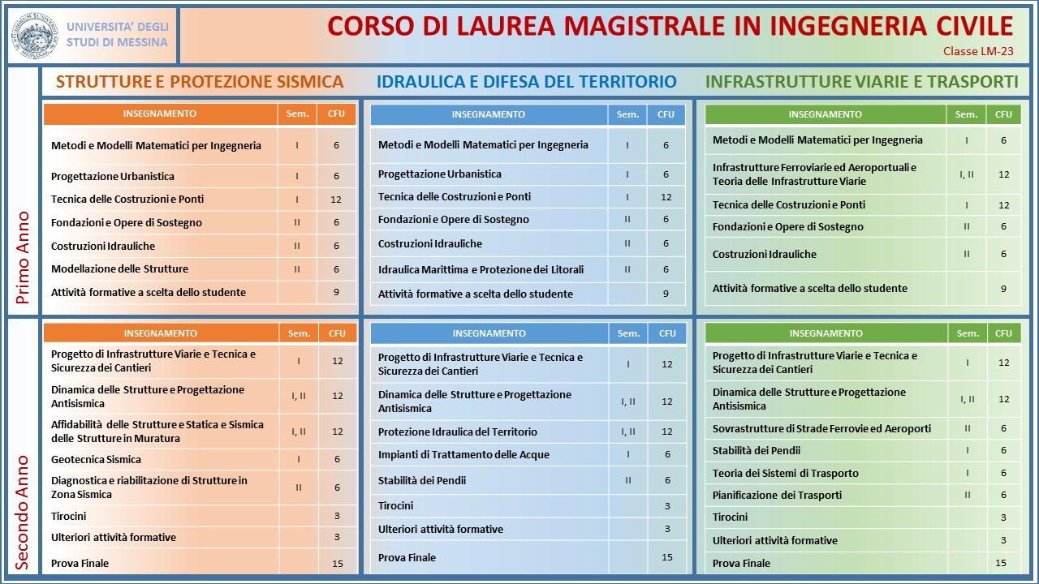
Development of master curricula for natural disasters risk management in Western Balkan countries

Slide 9
Protection and Management of Territory and the Natural Environment (TEAM).
Development of master curricula for natural disasters risk management in Western Balkan countries
The Master Degree in Protection and Management of Territory and the Natural Environment, aims to achieve a degree finalized to prepare a Msc in Natural Sciences who will be able to work as Risk Manager both in the public services (Civil Protection) and in the private consultancies (Safety Expert).
This graduate study is articulated in two years with about 60 credits per year: 11 courses of 6-12 CFU, 1 professional internships of 6 CFU and 3 CFUs for attending courses, conferences or carrying out other professional activities.

Slide 10
Protection and Management of Territory and the Natural Environment (TEAM).
Development of master curricula for natural disasters risk management in Western Balkan countries

Slide 11
Protection and Management of Territory and the Natural Environment (TEAM).
Development of master curricula for natural disasters risk management in Western Balkan countries

Slide 12
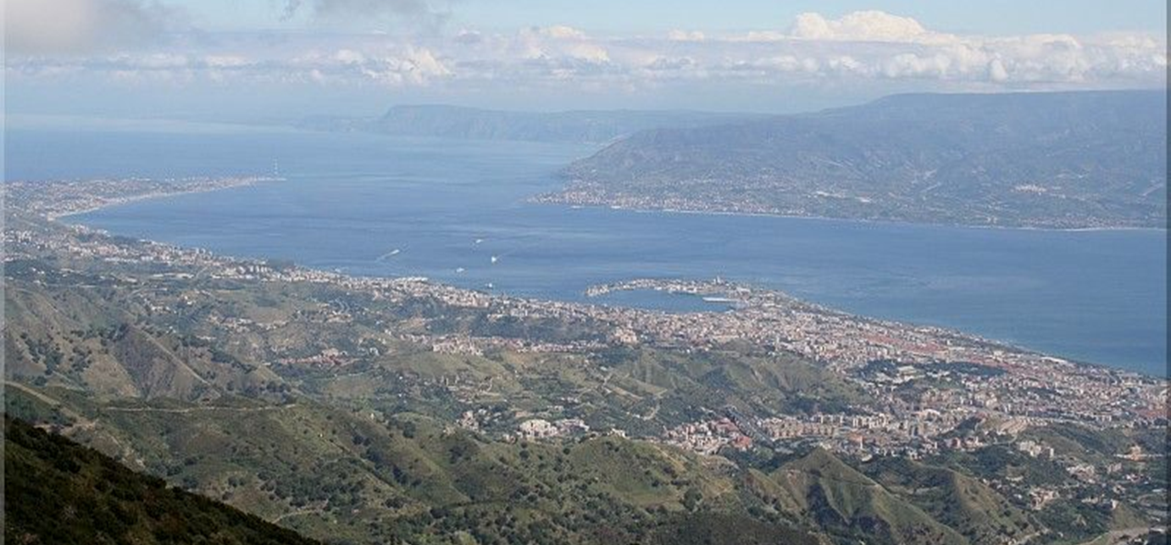
Thank you for your attention
Development of master curricula for natural disasters risk management in Western Balkan countries

